Slide 1
Фонетический турнир

Slide 2


Slide 3
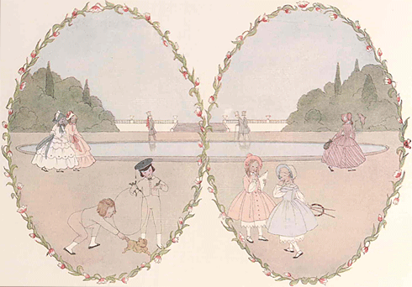

Slide 4
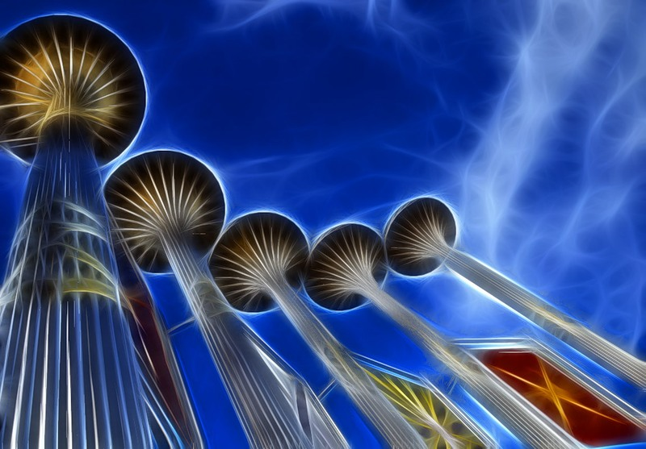

Slide 5


Slide 6

Seasons

Slide 7
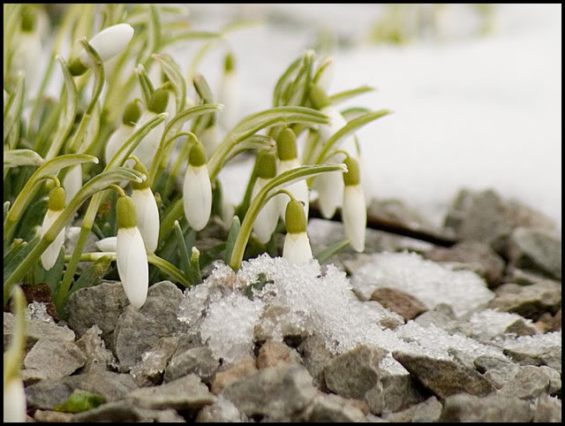

Slide 8


Slide 9


Slide 10


Slide 11


Slide 12


Slide 13


Slide 14
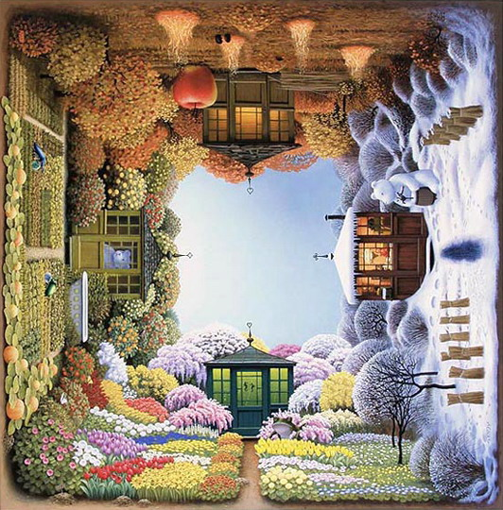

Slide 16

COLOURS

Slide 17


Slide 18


Slide 19


Slide 20


Slide 21


Slide 22

Animals

Slide 23
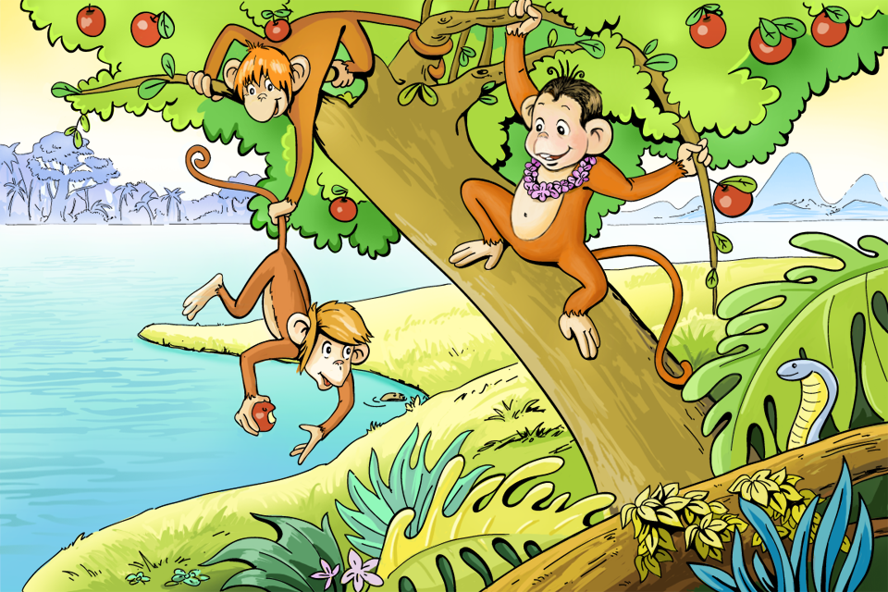

Slide 24
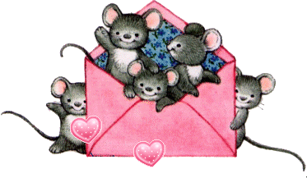

Slide 25
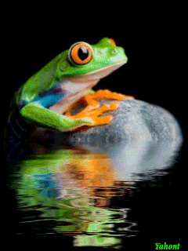

Slide 26
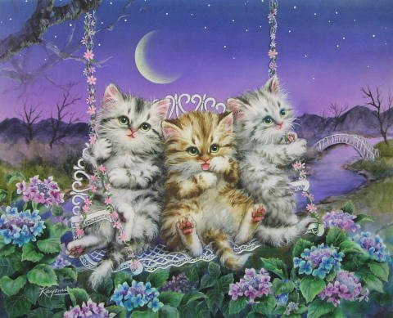

Slide 27

FAMILY & FRIENDS

Slide 28
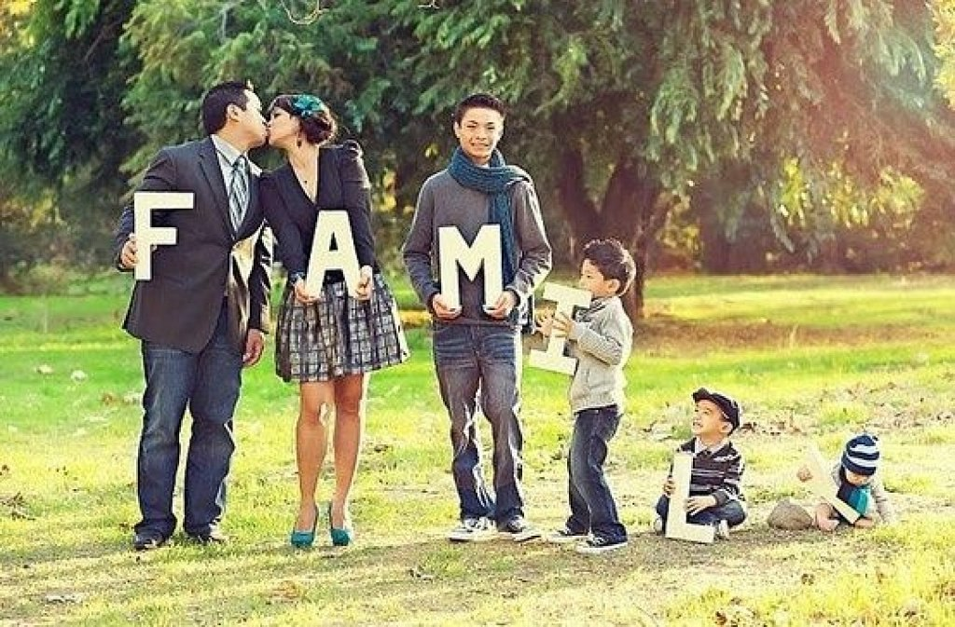

Slide 29


Slide 30


Slide 31
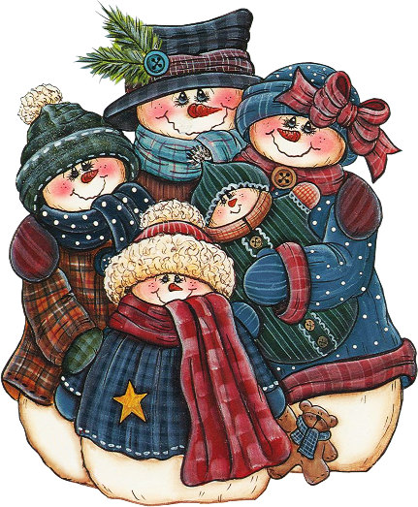

Slide 32


Slide 33
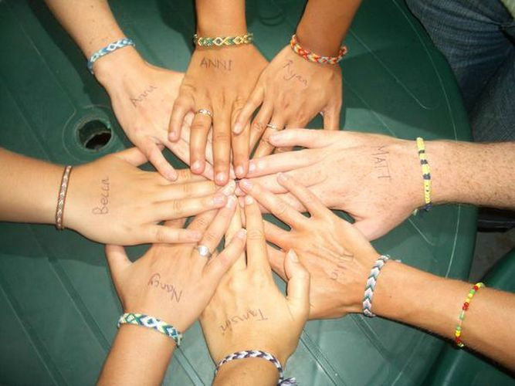

Slide 34


Slide 35


Slide 36
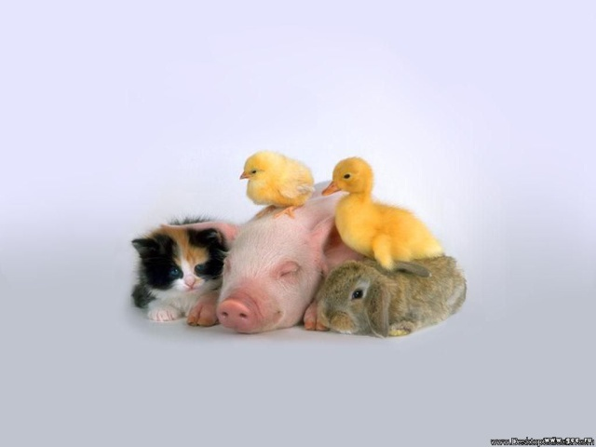

Slide 37
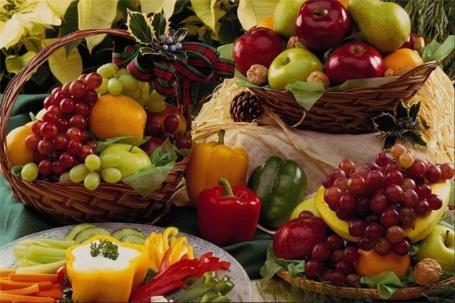
FOOD

Slide 38
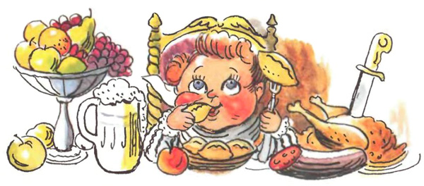

Slide 39
FOOD

Slide 40
FINE

Slide 41
EIGHT

Slide 42
SUN

Slide 43
SEE

Slide 44
COW

Slide 45
BYE

Slide 46
TAG

Slide 47
DAY

Slide 48
TOY

Slide 49
YOU

Slide 50
FAST

Slide 51
STREET

Slide 52
EAT

Slide 53
DISH

Slide 54
CARROT

Slide 55
SILK

Slide 57


Slide 58

GOOD LUCK!

