Slide 1

КВН по английскому языку

Slide 2

Hello!
My name is Jason!
I am glad to see you. Today we are playing KVN. I think you don`t know English language. There are 12 tasks. I wish you success!

Slide 3
1 команда
We can read, we can write, We can speak English, too. We love learning English! And what about you?

Slide 4
2 команда
Together, together, together every day Together, together We learn and we play.

Slide 5

You must listen and repeat the sentences to each other.
( аналог игры «Испорченный телефон»)

Slide 6
We like skiing in winter.
I like helping my mother about the house.
We like singing English songs together.

Slide 7

Musical Box

Slide 8
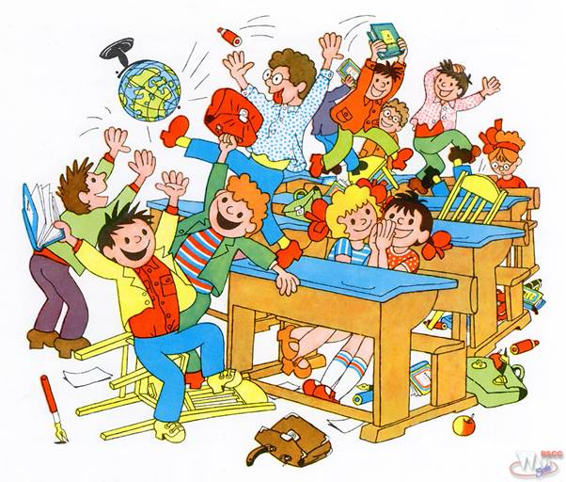
Homework video
“My Class”

Slide 9

Now, children,
say antonyms:
sister old yes black short father hello small up white bad goodbye girl can good hello no new long brother big mother can’t down no boy short

Slide 10


black – white long – short
yes – no father - mother
up – down no – yes
hello – goodbye happy – sad
small – big can – can’t
good – bad girl – boy
new – old sister – brother

Slide 11
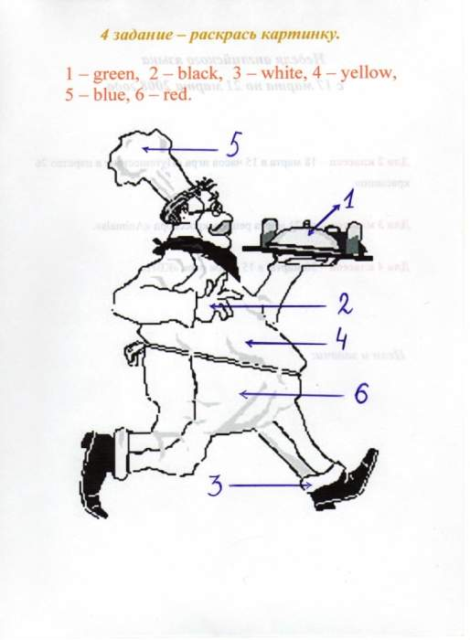
The next task is
to paint the picture

Slide 12
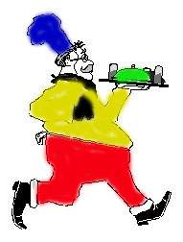

Let`s check:

Slide 13
I like labyrinths. The next task is writing a phrase.
N
S
V
I
T
I
H
K
S

Slide 14


This is KVN

Slide 15

Now make sentences:

Slide 16


I usually watch TV on Sunday.
She always plays the piano at home.
We often cleans his teeth in the morning.
He doesn`t read fairy-tales to my sister.
It`s time to go to bed.
He likes jam, cakes, sweets.

Slide 17
Now you have to find 9 animals in the crosswords:
e | s | g | s | a | a | s | c | a | t
r | m | i | a | p | i | g | s | s | r
h | o | r | s | e | d | e | s | c | d
u | u | a | a | d | g | l | i | o | n
o | s | f | t | i | g | e | r | c | d
o | e | f | r | o | g | p | y | k | s
y | h | e | n | o | o | h | r | u | r
w | f | i | s | h | g | a | y | i | z
d | o | g | q | m | o | n | k | e | y
c | f | e | e | u | y | t | h | m | n

Slide 18

e | s | g | s | a | a | s | c | a | t
r | m | i | a | p | i | g | s | s | r
h | o | r | s | e | d | e | s | c | d
u | u | a | a | d | g | l | i | o | n
o | s | f | t | i | g | e | r | c | d
o | e | f | r | o | g | p | y | k | s
y | h | e | n | o | o | h | r | u | r
w | f | i | s | h | g | a | y | i | z
d | o | g | q | m | o | n | k | e | y
c | f | e | e | u | y | t | h | m | n

Slide 19

Dear children, now I see that you know English very well. You are good pupils.
Thank you for your hard work.
See you again.
Good Bye.

Slide 20

Good for you!

